Slide 1
Following are graphics used as Figures in the document.

Slide 2
Errors of
Omission
Everything that was done
The GREEN ZONE
Everything that should be done
Errors of Commission

Slide 3
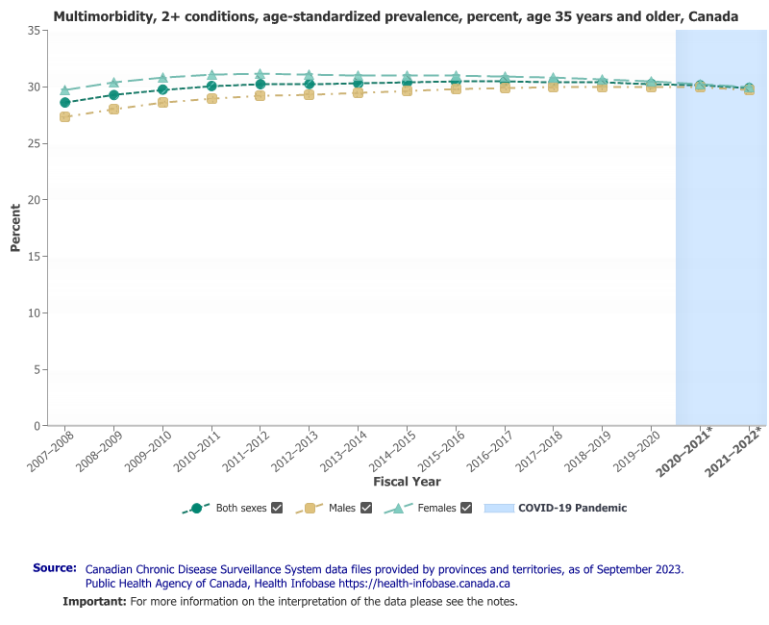

Slide 4
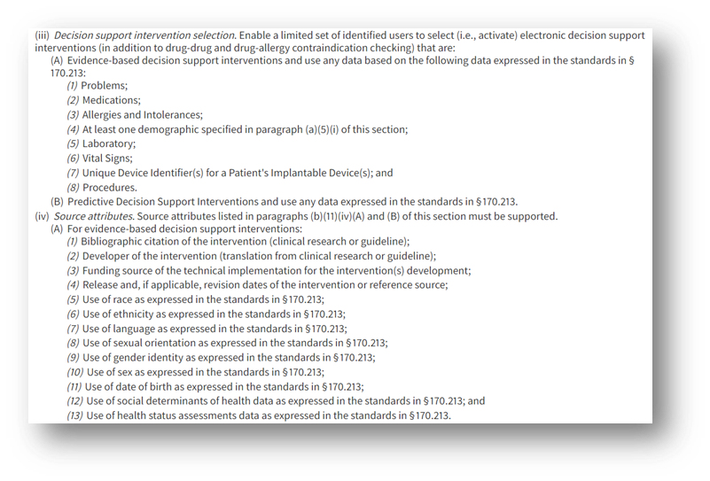
Replaced

Slide 5
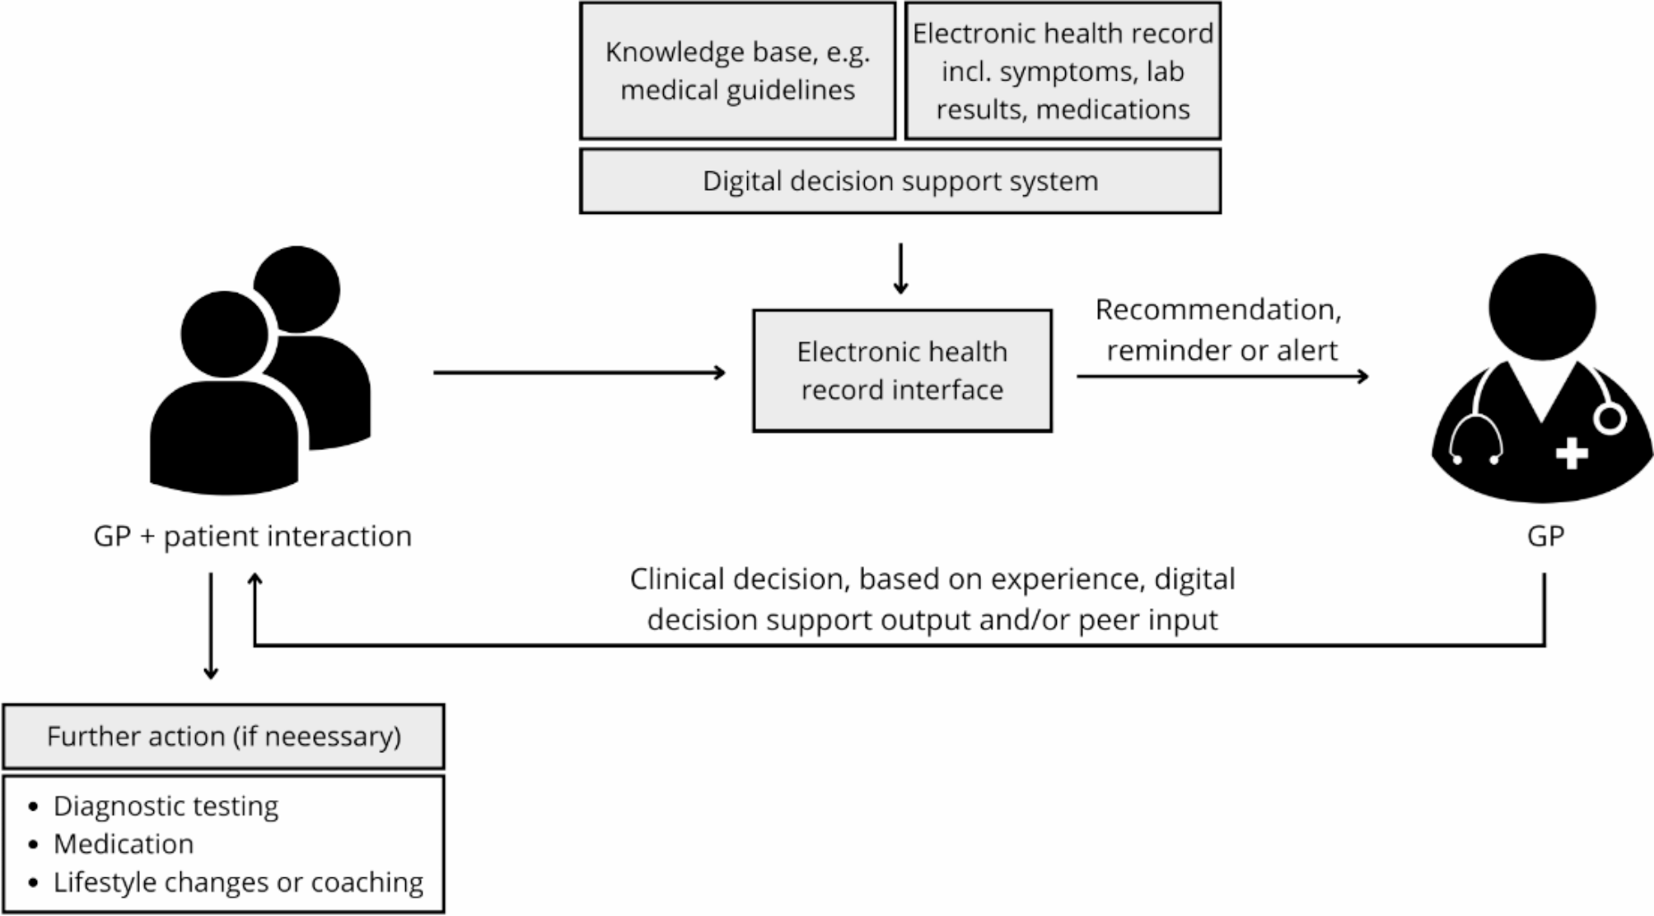

Slide 6

CARD type
CARD unique ID
Condition for which the card is applicable
Action that results from “playing the card”
Resulting Data from the action
CCG Folder
Folder unique ID
One folder per care guideline
(FHIR PlanDefinition resource)
One card per guideline-based recommendation
(A PlanDefinition containing a single ActivityDefinition resource based on one of the pre-defined card “types”)
Notes:
To help understand how the process and data models interact, a folder-full-of-cards metaphor may be leveraged.
Each care guideline is a folder… and there is a card in the folder for each evidence-based recommendation.
Each card has a type and a unique ID… and the card is applicable when its condition evaluates to TRUE.
For an applicable card, there is an action… and when the action is taken, there is a result.
When a patient is enrolled in a guideline-based plan of care, we can think of it as associating the applicable folder with that patient.

Slide 7
T1
T2
D1
F1
2
The colour indicates the workflow state trigger associated with each CARD:
T1 (1, 4)
T2 (2, 3)
T3 (5, 6)
T4 (7)
T5 (8, 9)
D2
1
3
T1
T3
T4
T5
D1
F2
5
7
8
D3
4
6
9
D4

Slide 8
1
D1- AND C1-
To flatten the CARDs, the condition statements are the only elements used to determine if a CARD fires true or not. The triggers are ignored. NOTE: a CARD’s condition statement can ensure it will fire true only once per encounter.
This approach is not prescriptive regarding the flow of the care path.
EXAMPLE (flattened F1 & F2):
$apply
IF D1+ AND NOT(C2, C5, C7, C8): C2, C5, C7, C8
IF D1- AND NOT(C1, C4): C1, C4
$apply
IF D1+ AND C2+ AND C5+ AND C7+ AND C8+: DONE
IF D1- AND C1+ AND C4+ AND D2+ AND D3+: DONE
IF D1- AND D2- AND C3-: C3
IF D1- AND D3- AND C6-: C6
$apply
IF D1- AND D2- AND C3+ AND D3+: DONE
IF D1- AND D3- AND C6+ AND D4+: DONE
IF D1- AND D3- AND D4- AND C9-: C9
$apply
IF D1- AND D3- AND D4- AND C9+: DONE
F1
2
D1+ AND C2-
3
D1- AND D2- AND C3-
4
D1- AND C4-
5
D1+ AND C5-
6
D1- AND D3- AND C6-
F2
7
D1+ AND C7-
8
D1+ AND C8-
9
D1- AND D3- AND D4- AND C9-

Slide 9
participant "Care Plan Contributor" as cpc
participant "Guideline Performer" as gf
participant "Guideline Engine" as ge
participant "Care Plan Service" as cps
participant "Guideline Publisher" as gp
participant "Guideline Repository" as gr
loop during CCG authoring
opt if updating an existing CCG
gp -> gr: x1 Search for Guidelines
gr -> gp: x1 response
gp -> gr: x2 Retrieve Guideline
gr -> gp: x2 response
end opt
gp -> gr: x3 Publish Guideline*
gr -> gp: x3 response
end loop
note over gr: State-A: Well-formed CCGs exist in \nGuideline Repository
loop for each CCG refresh cycle
ge -> gr: x1 Search for Guideline
gr -> ge: x1 response
loop for every Guideline in need of refresh
ge -> gr: x2 Retrieve Guideline
gr -> ge: x2 response
end loop for Guideline refresh
end loop for refresh cycle
note over ge: State-B: updated CCGs exist on \nGuideline $apply Engine
loop for every update of a person's care plan
cpc -> cps: PCC-41 Search for Care Plan
cps -> cpc: PCC-41 response
cpc -> cps: PCC-38 Retrieve Care Plan
cps -> cpc: PCC-38 response
cpc -> cps: PCC-37 Update Care Plan
cps -> cpc: PCC-37 response
end loop
note over cps: State-C: one or more CCGs are \nassociated with a care subject
================================================================================
participant "Care Plan Contributor" as cpc
participant "Guideline Performer" as gf
participant "Guideline Engine" as ge
participant "Care Plan Service" as cps
participant "Guideline Publisher" as gp
participant "Guideline Repository" as gr
note over gr: State-A: Well-formed CCGs exist in \nGuideline Repository
note over ge: State-B: updated CCGs exist on \nGuideline $apply Engine
note over cps: State-C: one or more CCGs are \nassociated with a care subject
loop for each CCG-supported care encounter
note over cpc,cps: Guideline Performer establishes the necessary contextual pre-conditions to commencing the care encounter
note over gf: State-D: Care context expressed in \nCCG-adherent common data model
loop during a CCG-supported care encounter, until x4 response is empty
note over gf: Interim updated data, reflecting \nCCG-informed recommendations
gf -> ge: x4 Apply guideline
ge -> gf: x4 response
end loop
note over gf: State-E: Encounter results persisted \nper the CCG-adherent data model
end loop

Slide 10
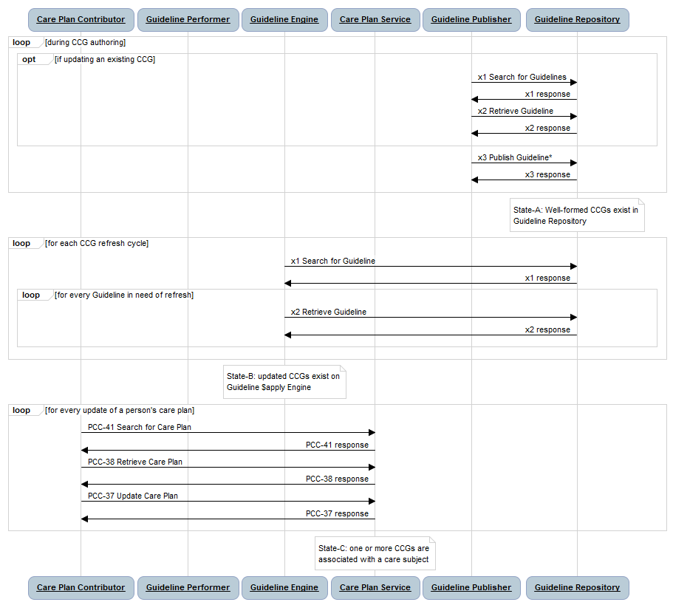
A Guideline Publisher may support x1, x2
A Guideline Publisher may support a digitally signed x3 payload (whole CCG, or reach CARD)
1
CCGs are published
State-A
A Guideline $apply Engine may support that only “trusted” CCG artefacts are available for execution.
2
$apply Engines regularly refresh their local cache of published CCGs.
State-B
3
Providers associate Patients with relevant CCGs
State-C

Slide 11
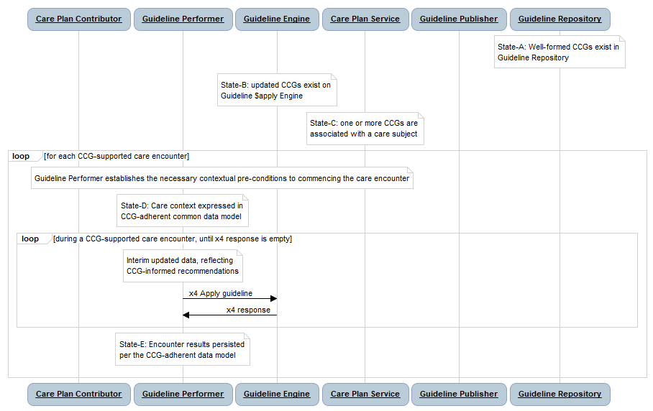
State-A
State-B
State-C
State-D
4
CCGs inform the course of patient care during an encounter
State-E

Slide 12














Financially sustains
Leverages
specs from
CCG Centre
of Excellence
Engages with for testing
Digital Health Agency
Leverages
specs from
Publishes
Publishes
CCGs
Clinical Colleges
Downloaded
and used by
Downloaded
and used by
Open-source
Tools
Conformance-
tests
Leveraged by
MOH
Purchases care
services from
Market their
products to
Claims Payment
Logic Engine
CCG-supported Care
Delivery Network
Digital Health
Solution Vendors
Engage with for testing
Exchanges
data with
Purchases from
Submits
claims to
Provides patient-safe, high-quality, evidence-based care to
Financially sustains
Jurisdictional HIE
(with hosted CCG Engine)
Population

Slide 13

CCG Builders
CCGs
Performance
Analytics
Care Delivery Network

Slide 14
What if omitting some “indicated” care activities statistically yields identical (or even better) health outcomes?
What if some “non-indicated” care activities systemically yield better health outcomes?
The GREEN ZONE

Slide 15






Associate CCGs
with Patient
PS
Leverage CCGs
during care
PS
PS

Slide 16
QRPH-61: Search for Guideline
QRPH-62: Retrieve Guideline
QRPH-63: Publish Guideline*
1
Guideline
Publisher
Guideline
Repository
In an out-of-band process, a list of available CCGs is made available for Care Providers to choose from.
CCGs are
published
$apply Engines regularly refresh their local cache of published CCGs.
2
QRPH-61: Search for Guideline
QRPH-62: Retrieve Guideline
Providers associate Patients with relevant CCGs
Care Plan
Contributor
Care Plan
Service
3
PCC-41: Search for Care Plan
PCC-38: Retrieve Care Plan
PCC-37: Update Care Plan
Guideline
Performer
Guideline
Engine
By assuming the Engine has the relevant CCGs, we can forego having to have the Performer hold a CCG copy and pass it to the Engine as part of the transaction bundle.
4
QRPH-64: Apply guideline
CCGs inform the course of patient care during an encounter
*A Guideline Publisher may digitally sign the top-level bundle (the folder) and/or may digitally sign every resource (each CARD, all libraries, etc.).

Slide 17
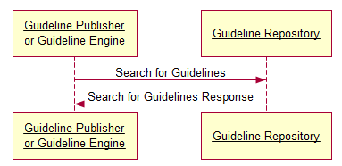
participant "Guideline Publisher\nor Guideline Engine" as a
Participant "Guideline Repository" as b
a -> b: Search for Guidelines
b -> a: Search for Guidelines Response

Slide 18
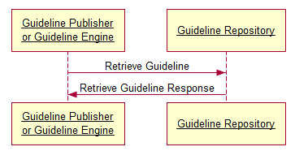
participant "Guideline Publisher\nor Guideline Engine" as a
Participant "Guideline Repository" as b
a -> b: Retrieve Guideline
b -> a: Retrieve Guideline Response

Slide 19
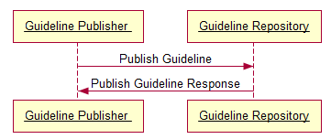
participant "Guideline Publisher " as a
Participant "Guideline Repository" as b
a -> b: Publish Guideline
b -> a: Publish Guideline Response

Slide 20
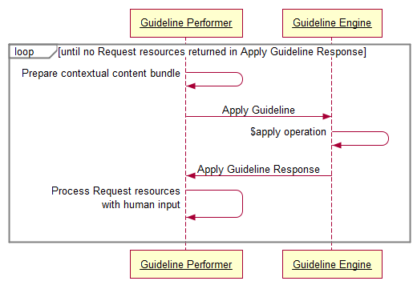
participant "Guideline Performer" as a
Participant "Guideline Engine" as b
loop until no Request resources returned in Apply Guideline Response
a -> a: Prepare contextual content bundle
a -> b: Apply Guideline
b -> b: $apply operation
b -> a: Apply Guideline Response
a -> a: Process Request resources\n with human input

Slide 21




CCG Package
ImplementationGuide (npm Package)
1..1 PlanDefinition (Folder level) per CCG Package
1..* PlanDefinition (CARD level) per Folder
1..1 ActivityDefinition (one of 13 CARD types)
0..1 Provenance
(optional digital signature, one for each resource)
CCG Folder
CCG CARD (PD)
CCG CARD (AD:1..13)
CCG CARD (PD)
...
CCG CARD (AD:1..13)
CCG CARD (PD)
CCG CARD (AD:1..13)

Slide 22
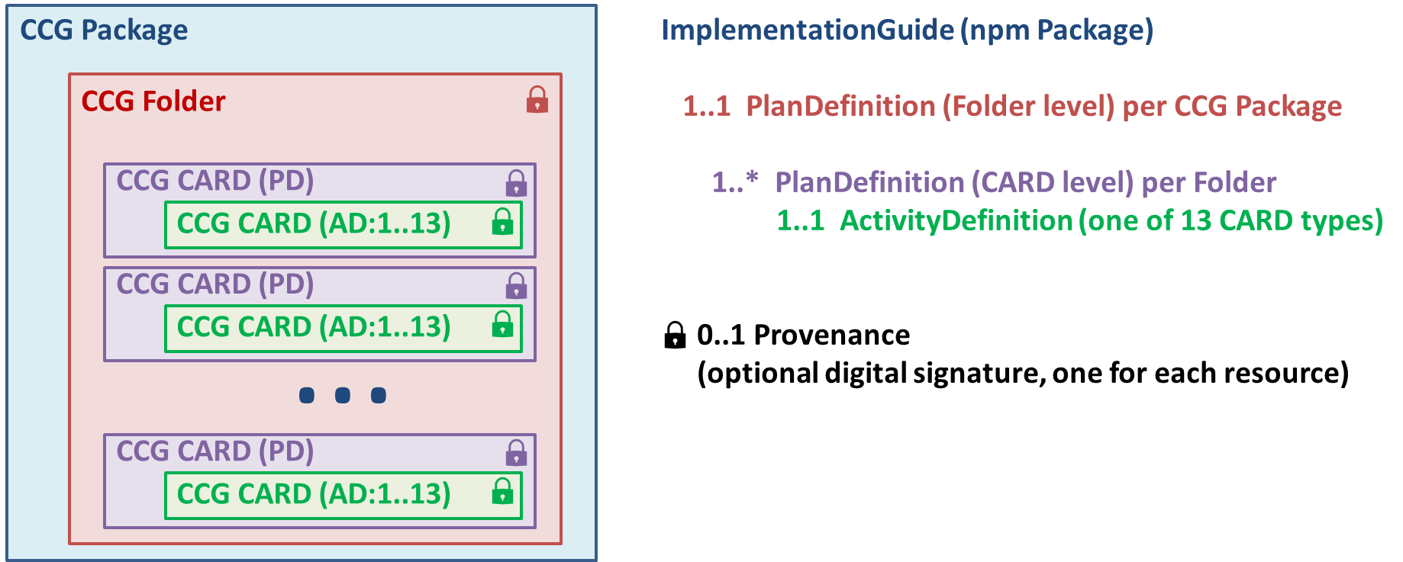
PNG file

Slide 23


Data-in Bundle
Encounter
Practitioner
Data-in Bundle
Encounter
PractitionerRole
Practitioner
Location
PractitionerRole
Organization
Location
IPS Bundle
CCG IPS Composition
Organization
…
IPS Resource (1)
IPS Bundle
CCG IPS Composition
IPS Resource (n)
…
RequestGroup
IPS Resource (1)
…
…
Recommended Action (1)
Resulting Data (1)
IPS Resource (n)
Recommended Action (n)
Resulting Data (n)
Initial Data-in Bundle included
in Apply Guideline transaction
Recommendations returned in
Apply Guideline response
Content added prior to each subsequent $apply iteration

Slide 24
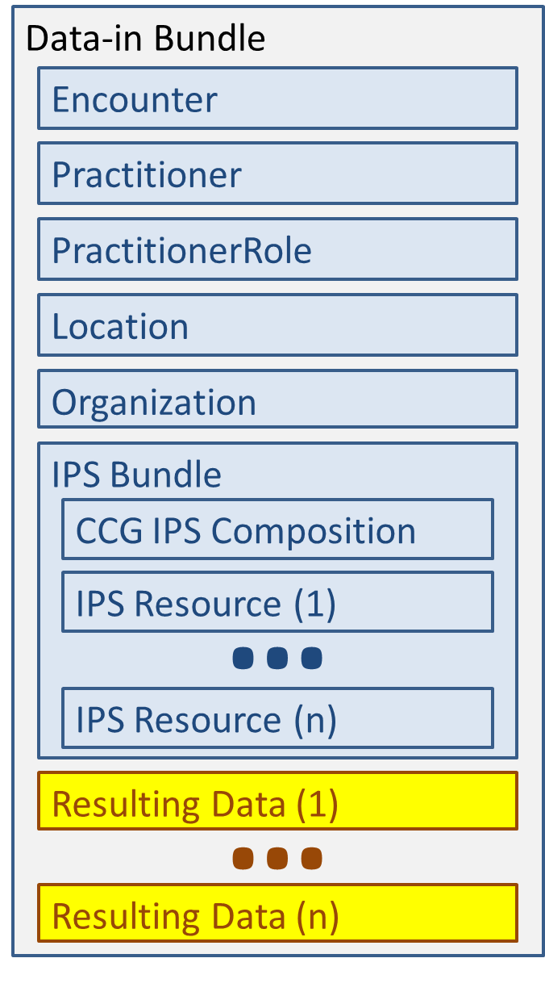
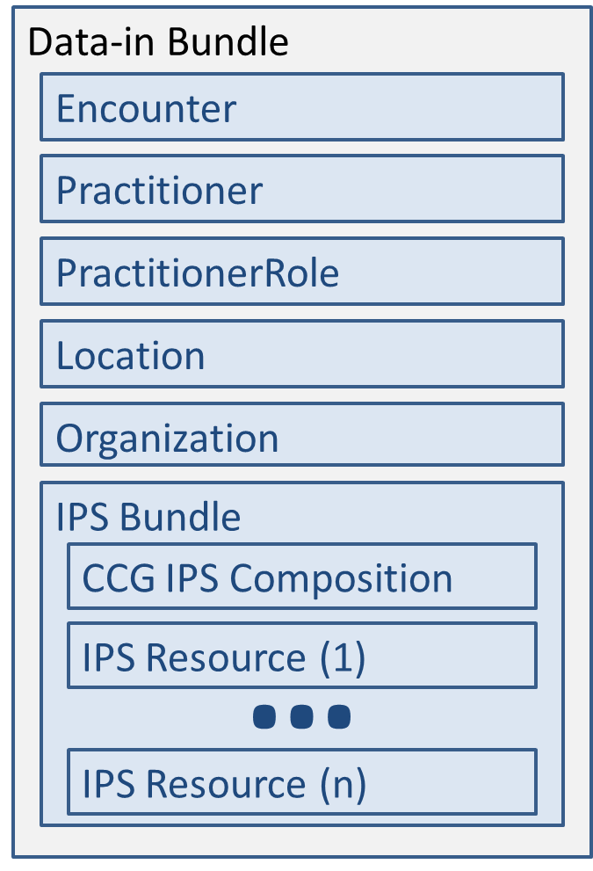

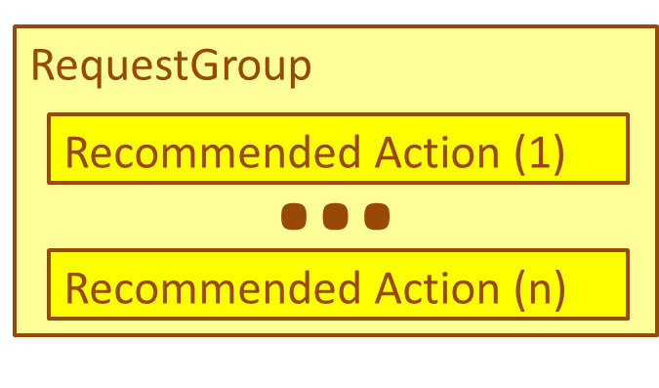

1
2
3
4
5
6
7

